Slide 1
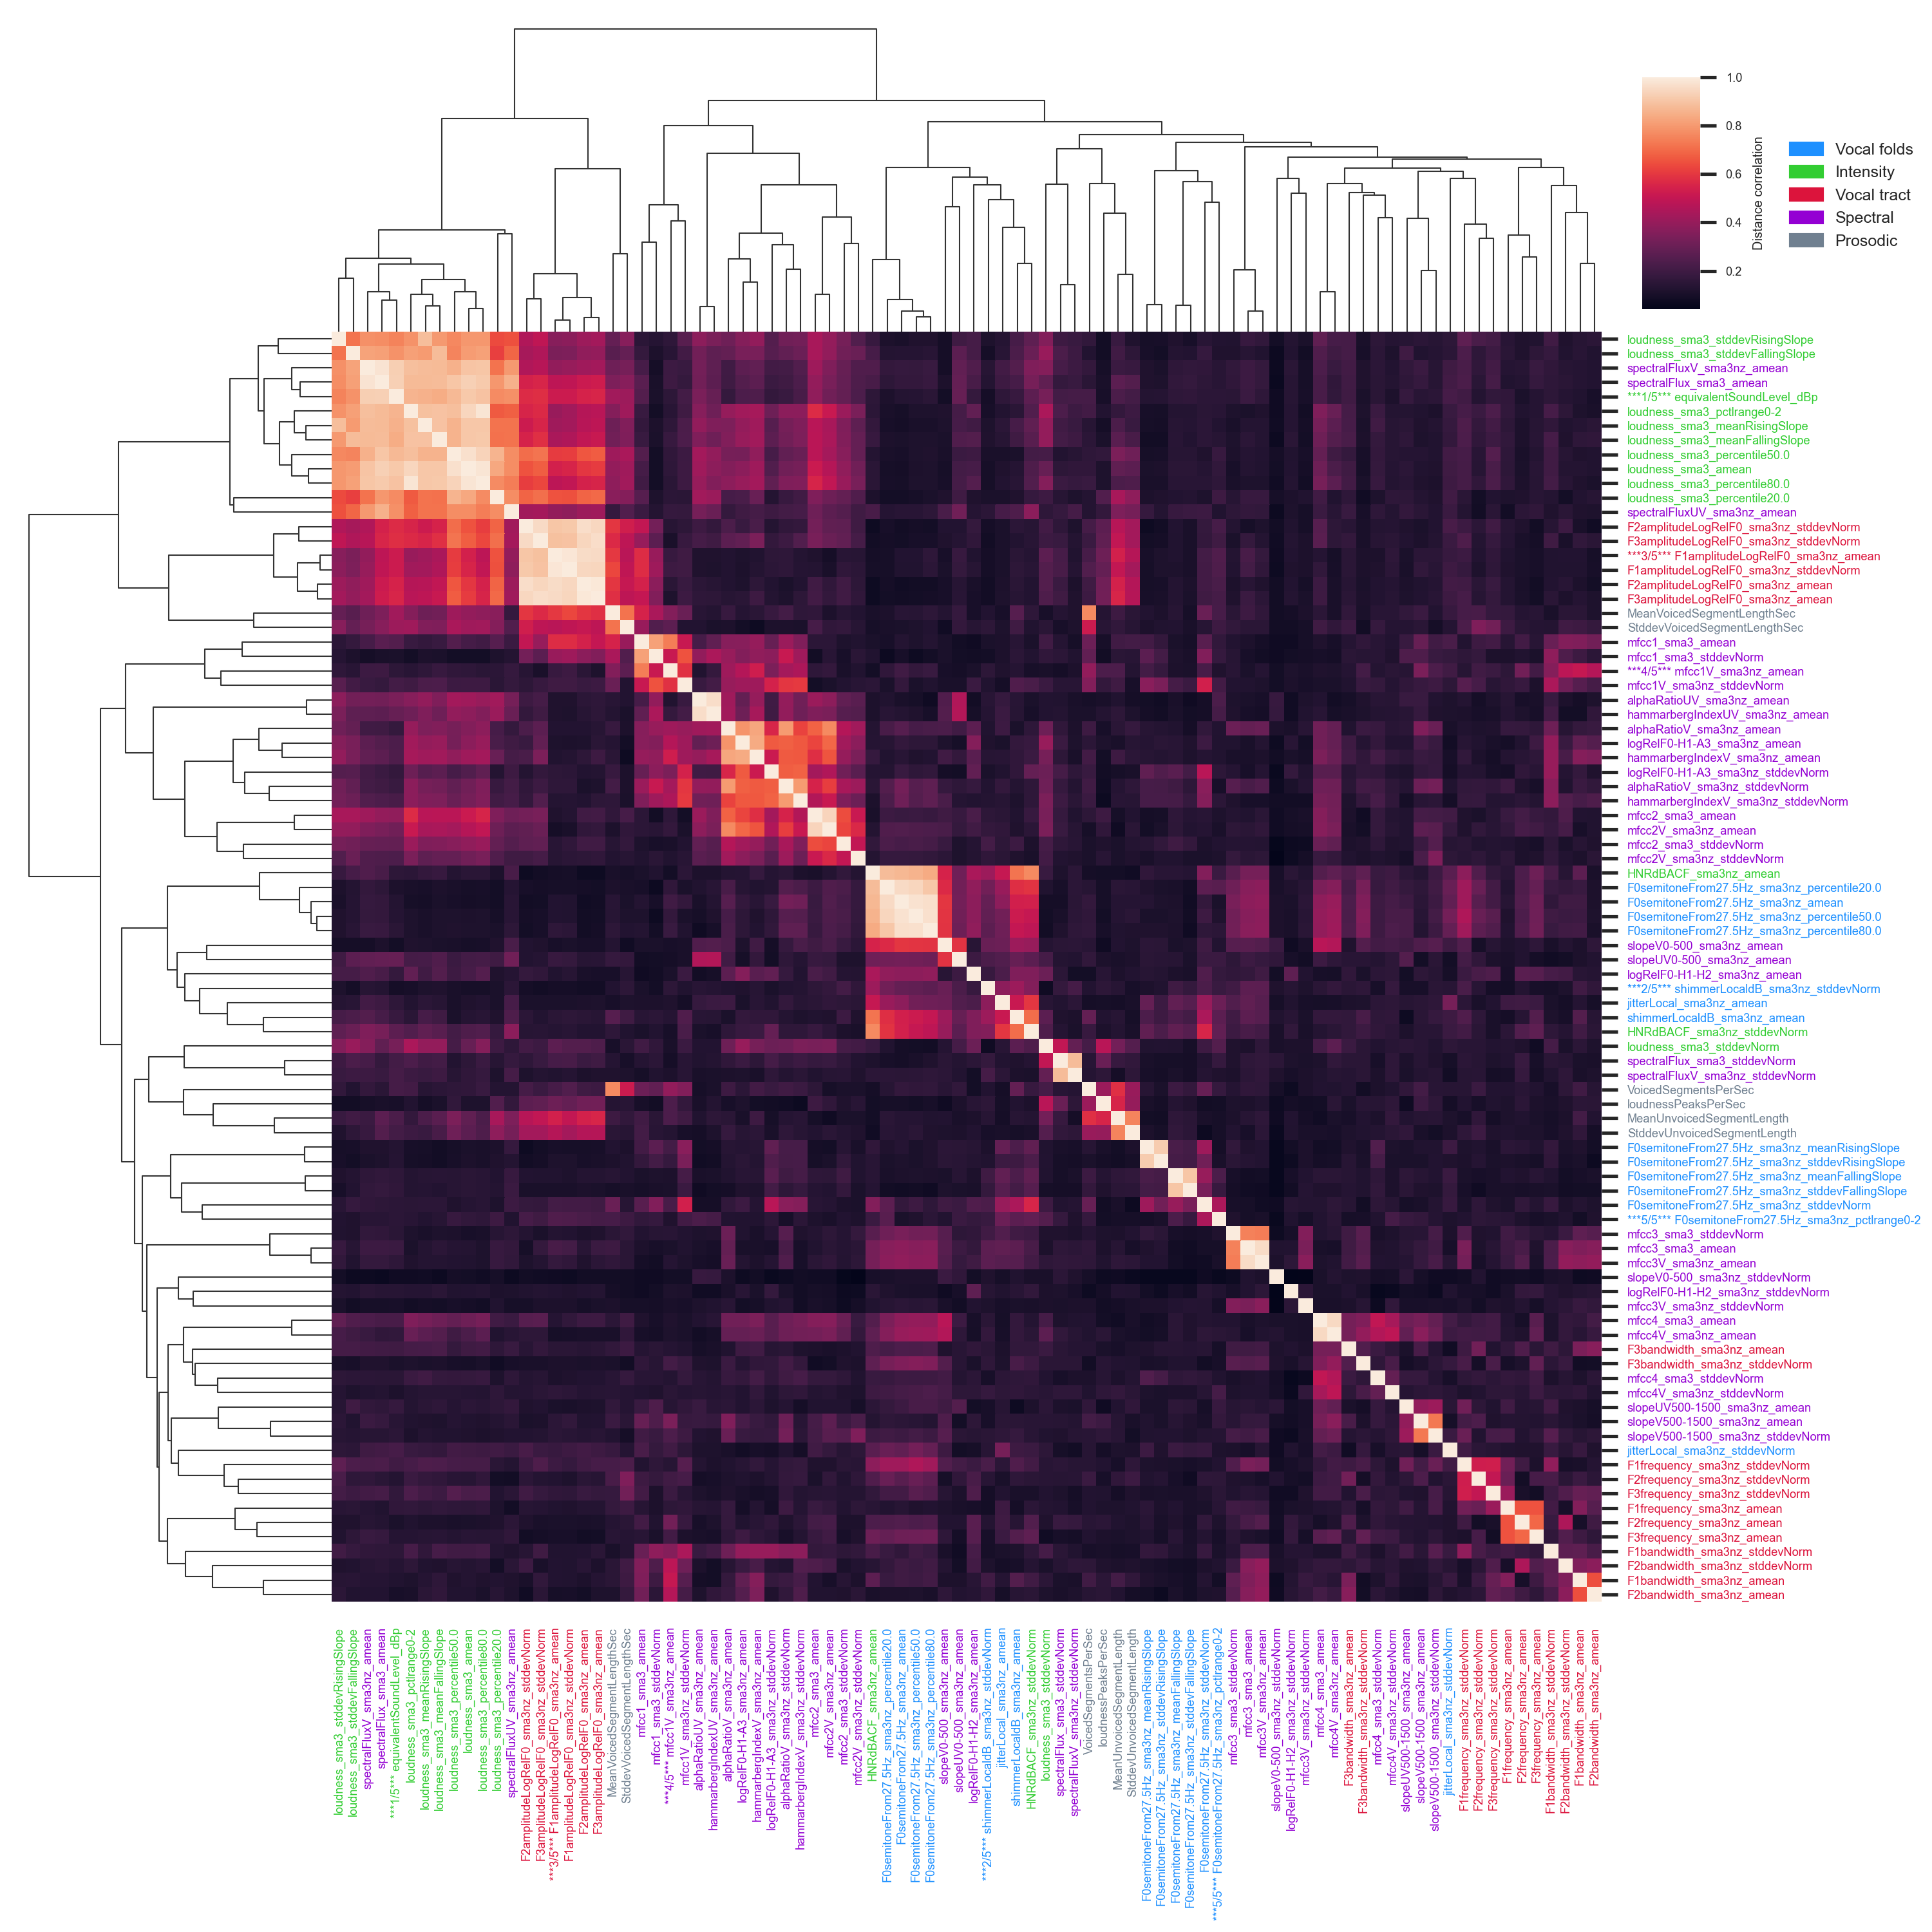
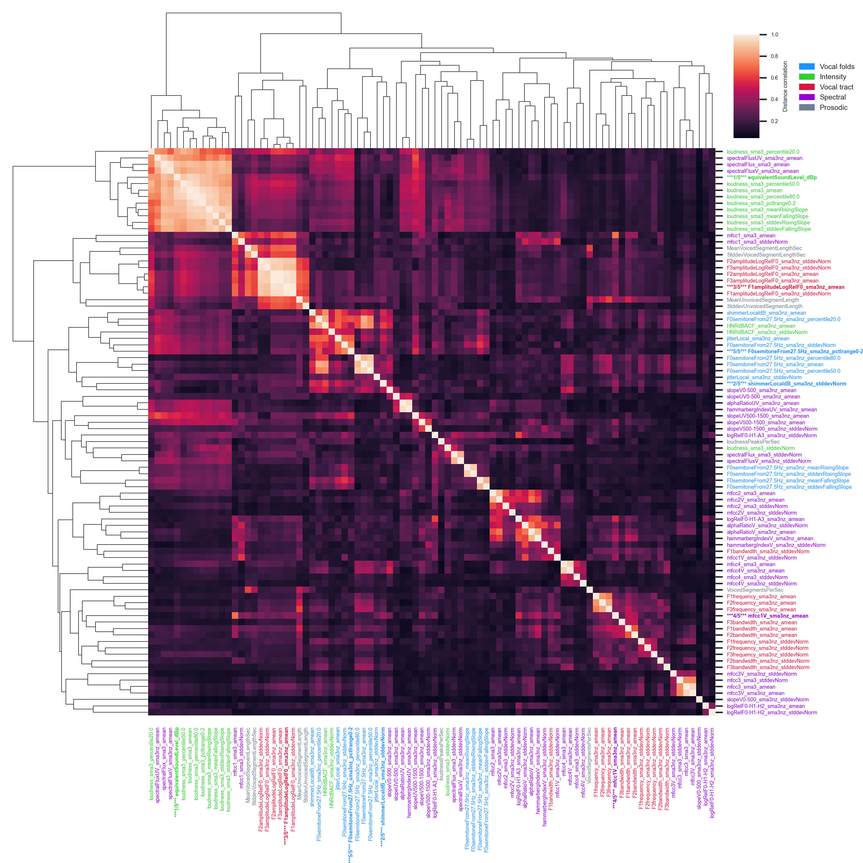
x
x
x
x
x
1
3
5
2
4

Slide 2
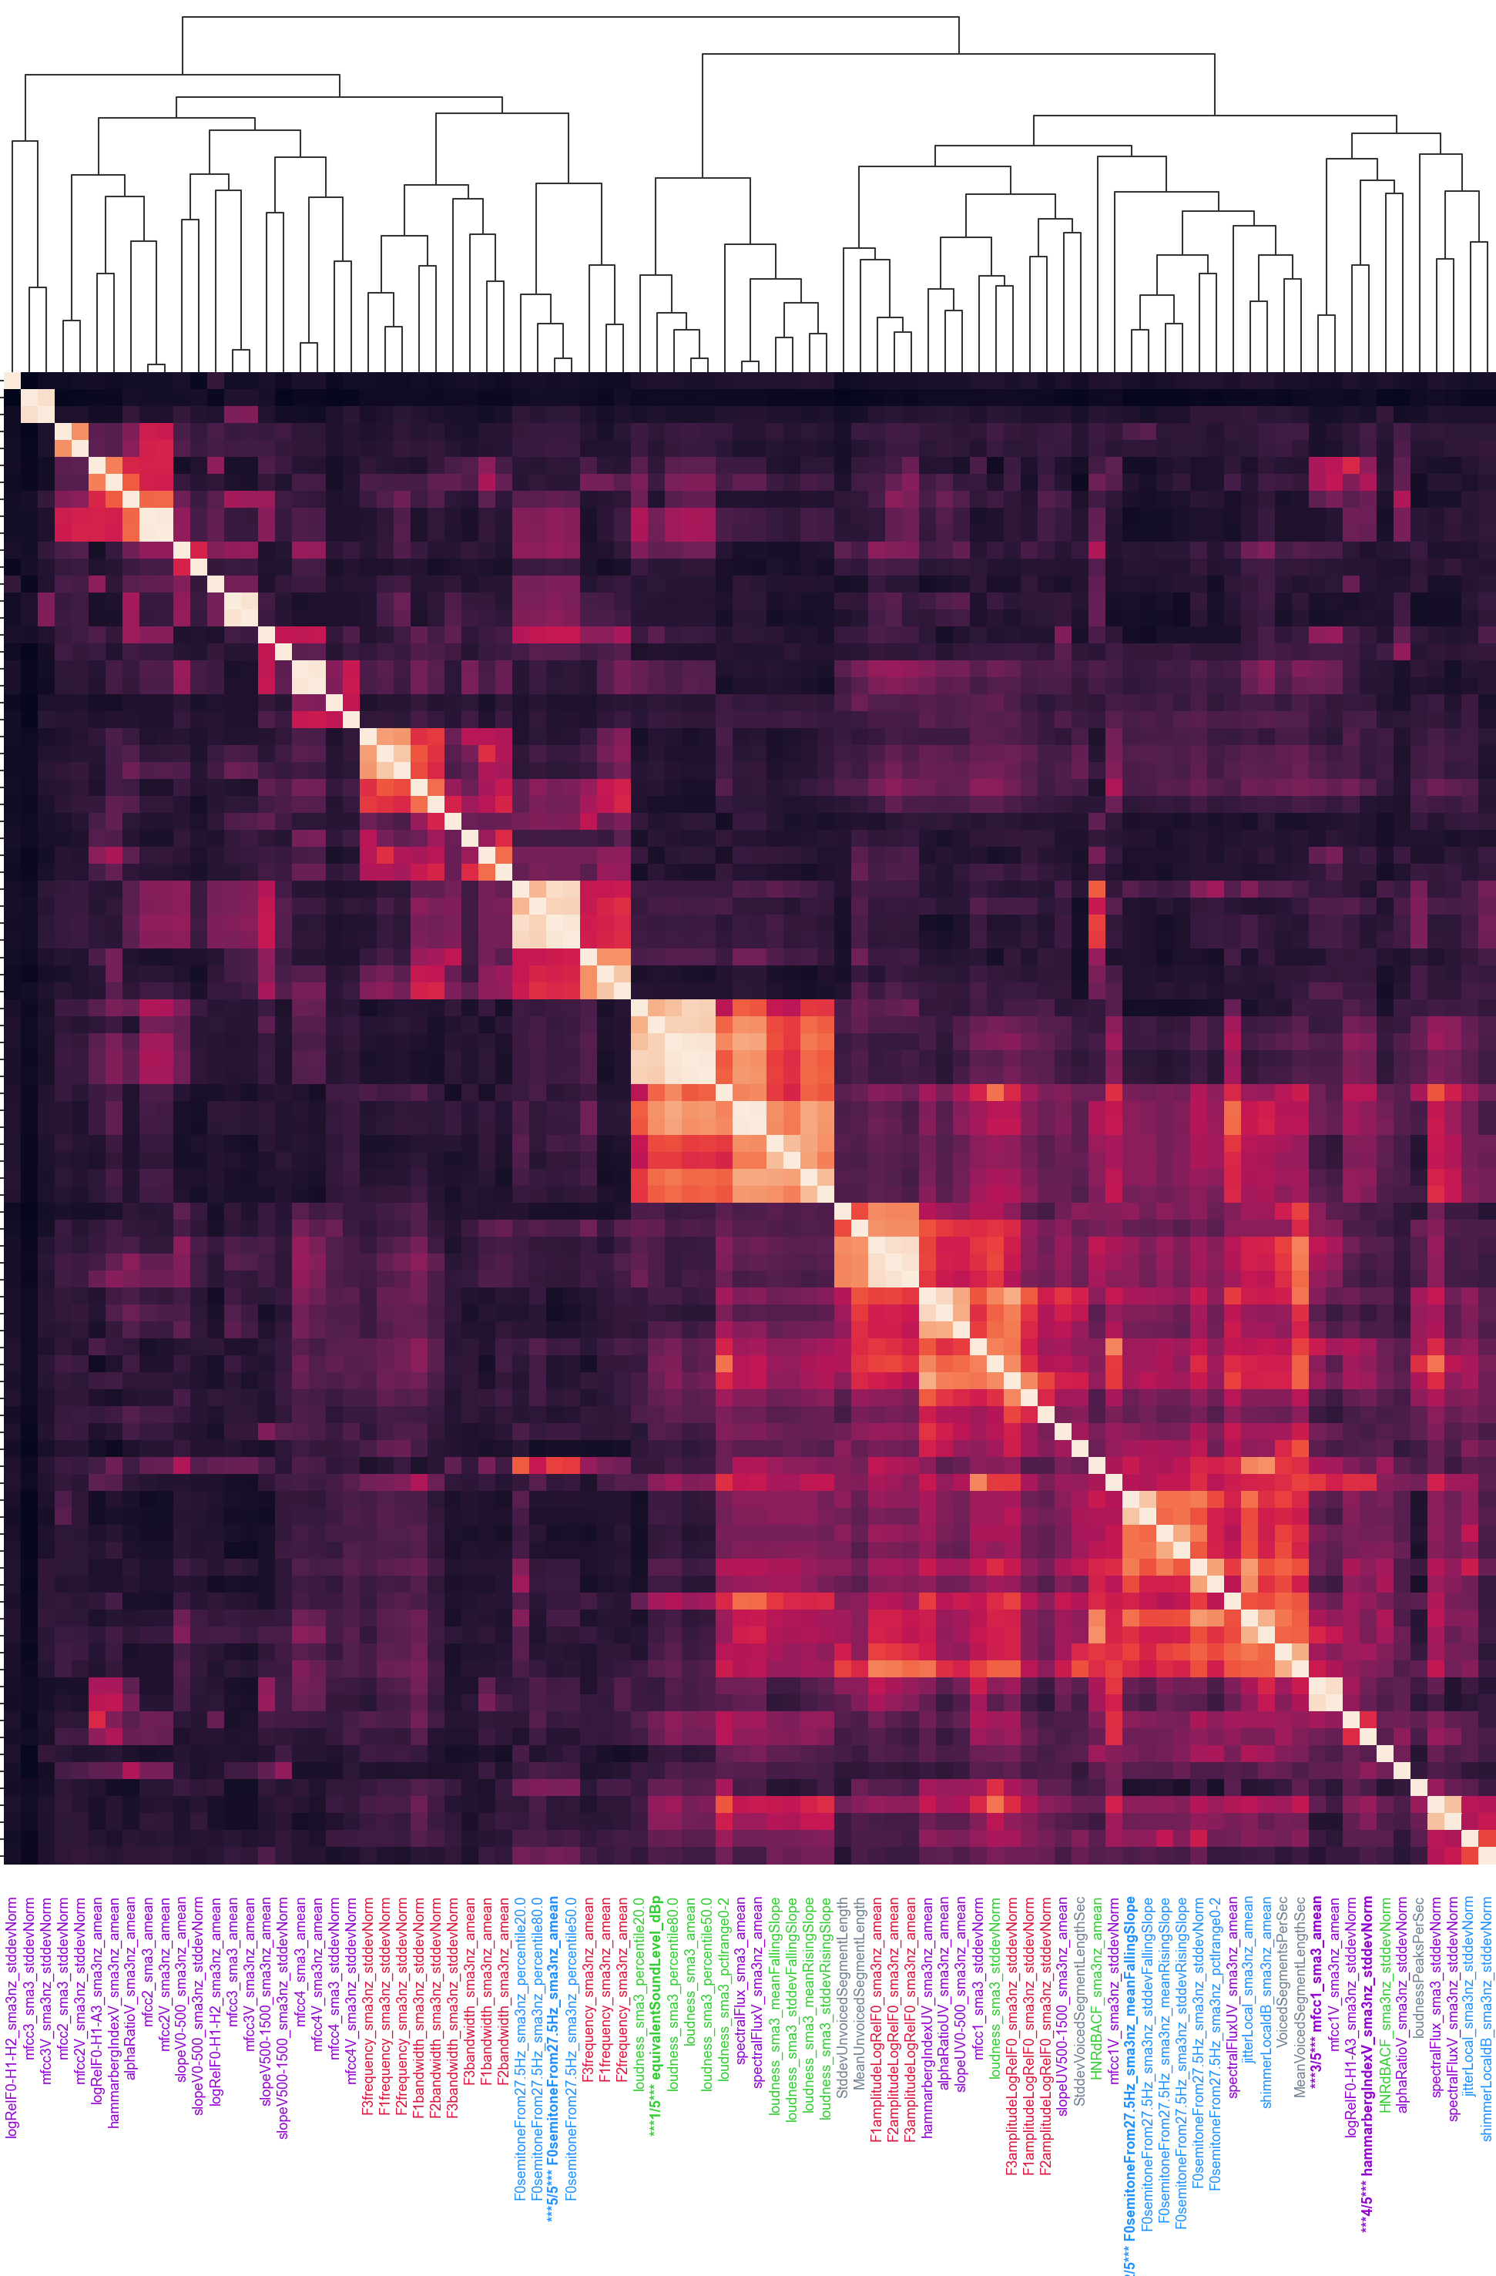
x
x
x
x
x
5
1
2
3
4

Slide 3
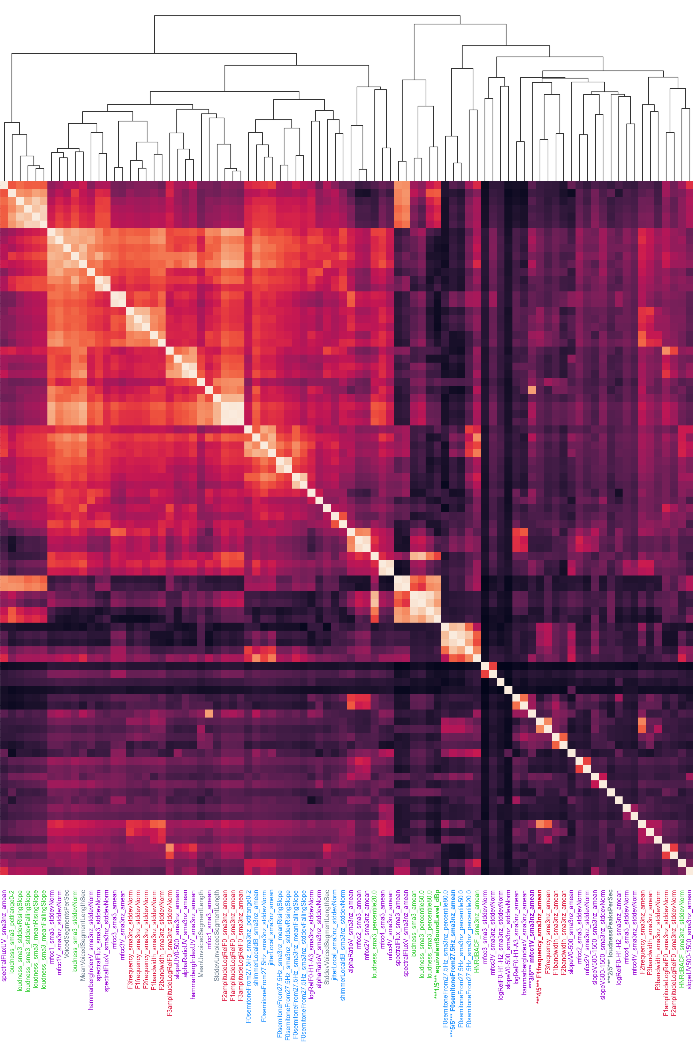
x
x
x
x
x
1
5
3
4
2

Slide 4
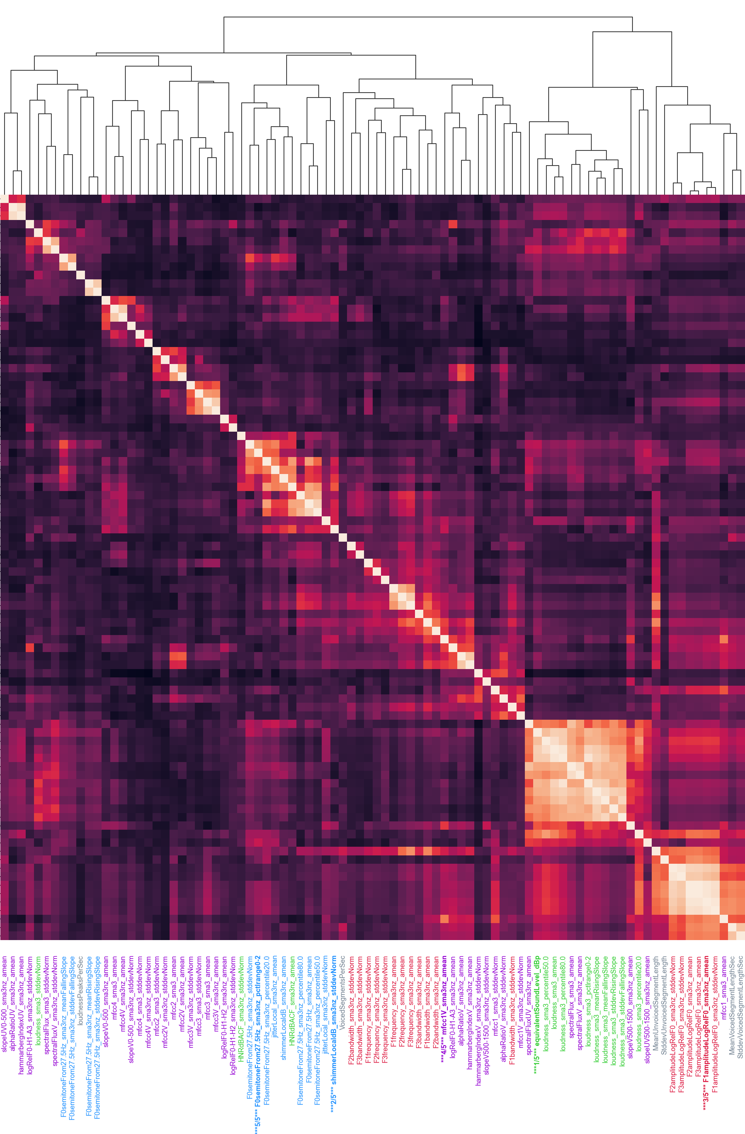
x
x
x
x
x
1
3
5
2
4

Slide 5
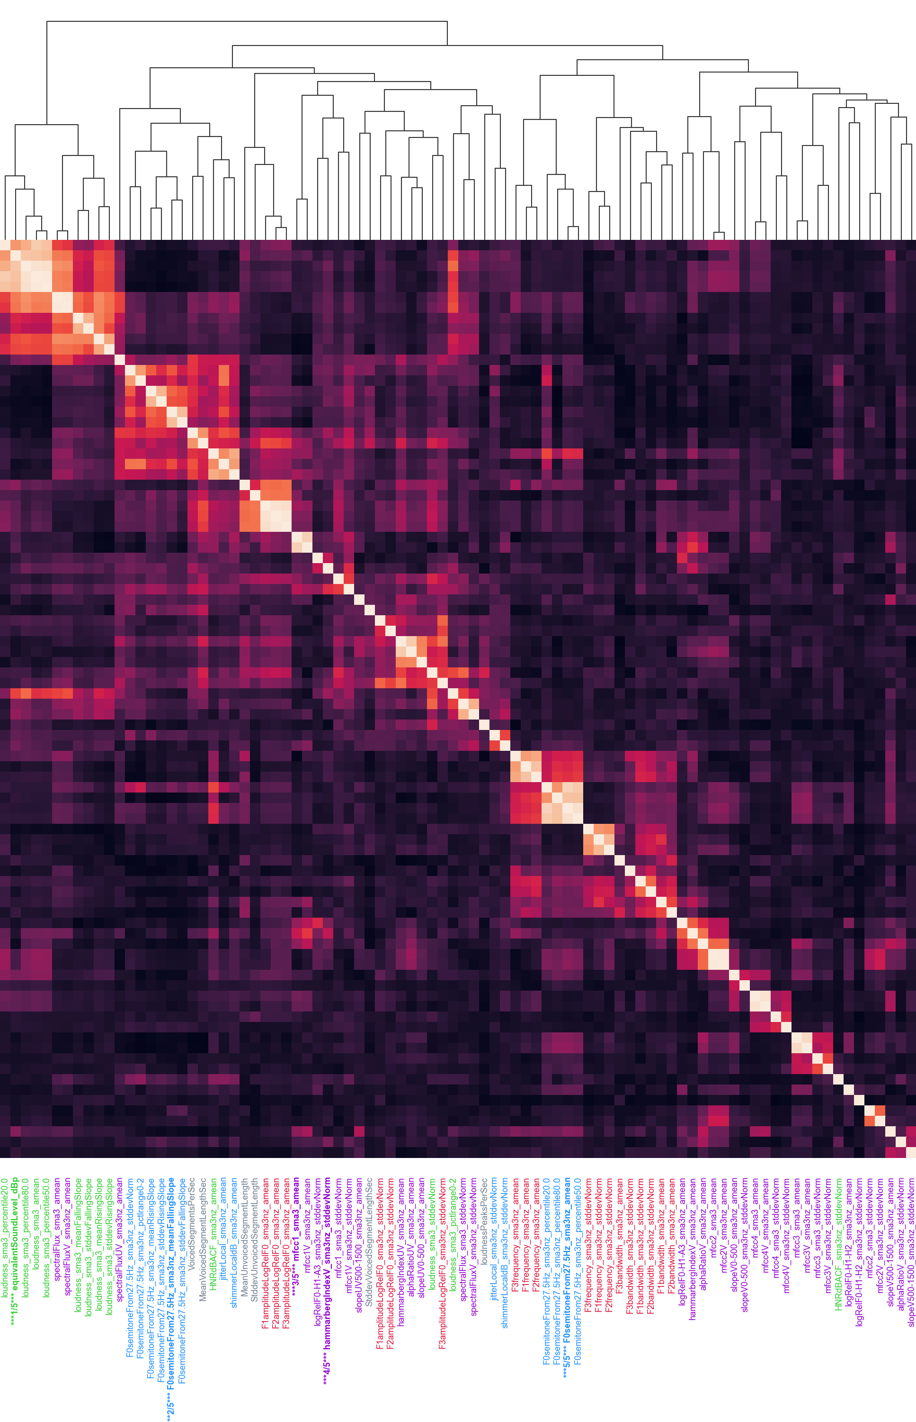
x
x
x
x
x
1
2
3
4
5

Slide 6
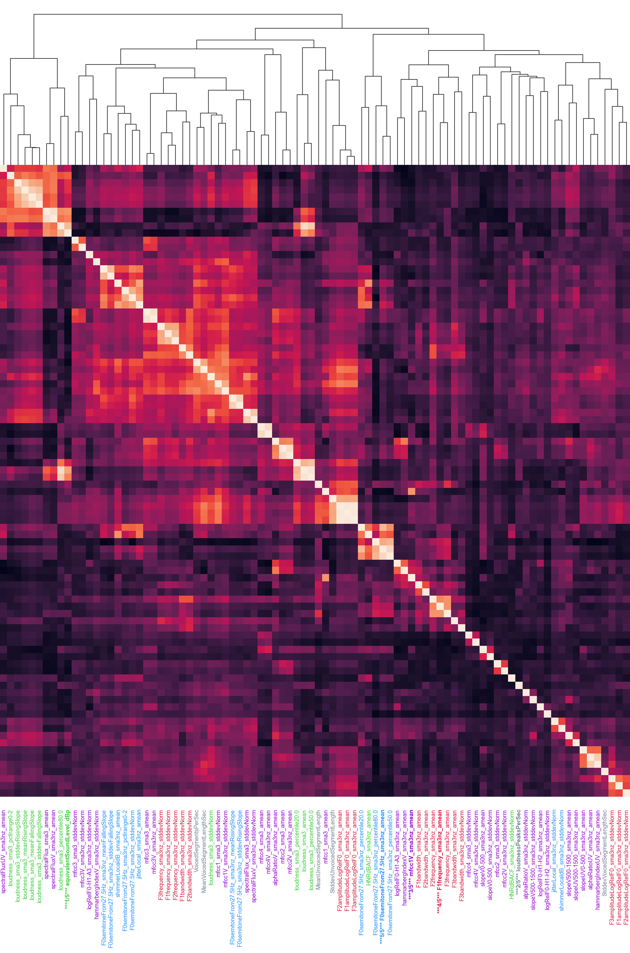
x
x
x
x
x
1
5
3
4
2

Slide 7

x
x
x
x
x
1
3
4
2
5

Slide 8
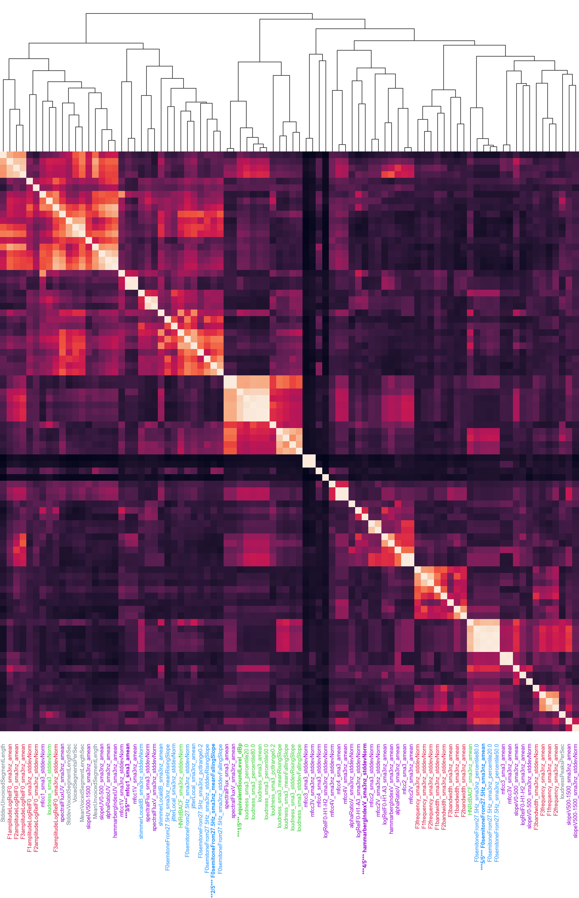
x
x
x
x
x
3
2
1
4
5

Slide 9
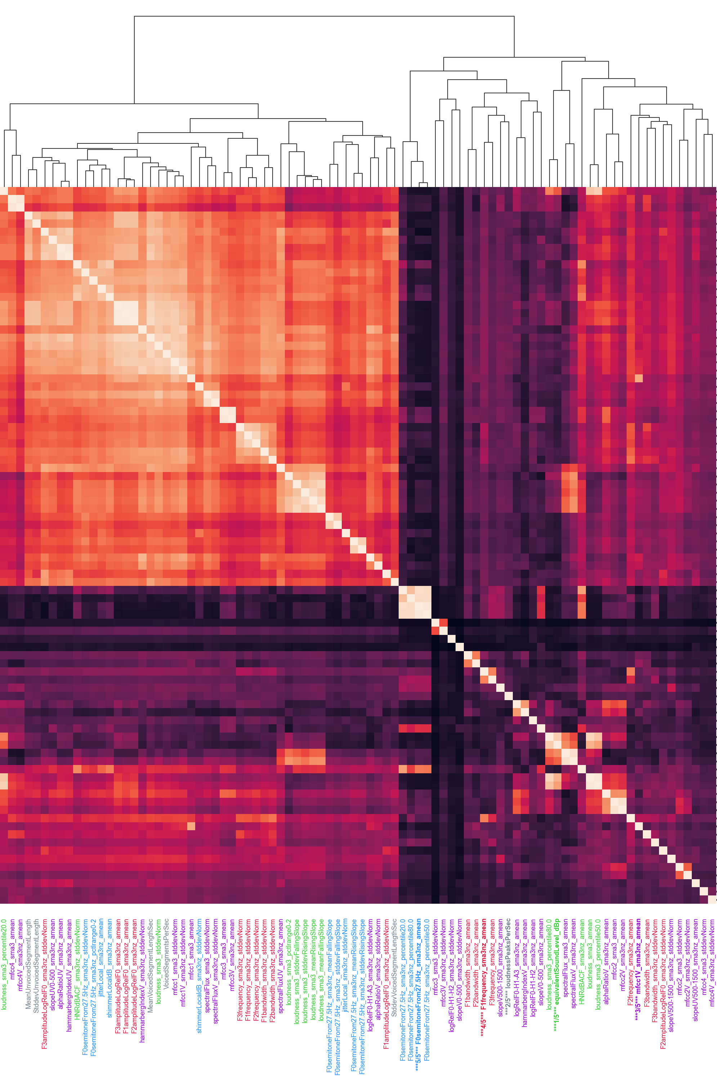
x
x
x
x
x
5
4
2
1
3

